Slide 1
Nondeterministic Actions
Can we use search techniques where action effects are non-deterministic?

Slide 2
Basic notion
In using BFS/ DFS/ A* etc., we create a plan (path) which is a sequence of actions (edges) starting from a given initial state (node) to a goal state (node).
If an action can lead to multiple states, then we must make sure we are prepared to deal with each of them.
Thus we can construct our plans to say what action to take depending on the action result.
‘Branching plans’ or ‘Contingent plans’
Note that it is still offline, i.e., the plan is constructed before execution.
The execution needs full observation through percepts, though.

Slide 3
The erratic vacuum world
Actions: Det. Semantics:
Left
Right
Suck
1
2
3
Actions: Err. Semantics:
Left
Right
Suck occasionally cleans adj square too
4
5
6
7
How do we create a plan to go from 1 to (7 or 8) ?
8

Slide 4
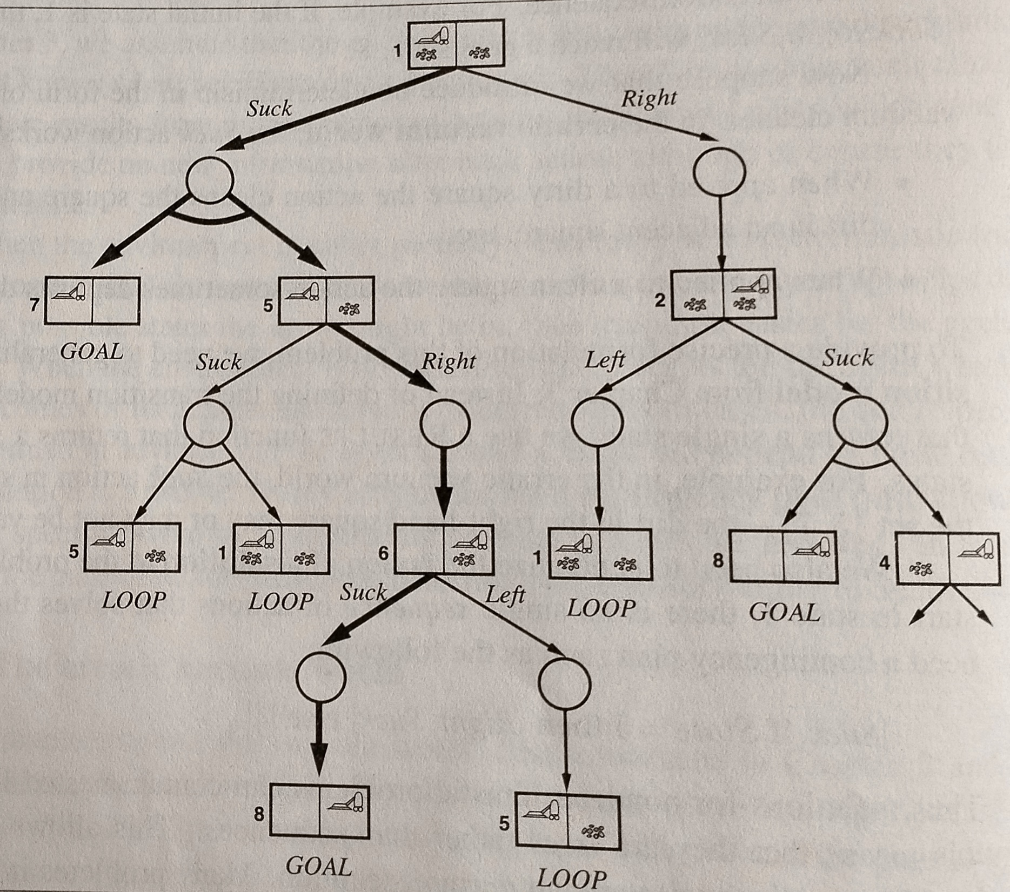
OR
AND-OR graph search
OR nodes – usual search nodes plan choses an action
AND nodes – a way to capture
Multiple states from an action
Resultant plan is a subtree.
All paths from the root in the
subtree lead to GOALs
AND
OR
AND
OR
Plan:
Suck if state==7 DONE(7)
Else // state==5
Right // state==6,Det
Suck
DONE (8)
AND
Fig 4.10
pp.136of RN

Slide 5
The slipping vacuum cleaner example
Actions: Err. Semantics:
Left go left or stay
Right go right or stay
Suck

Slide 6
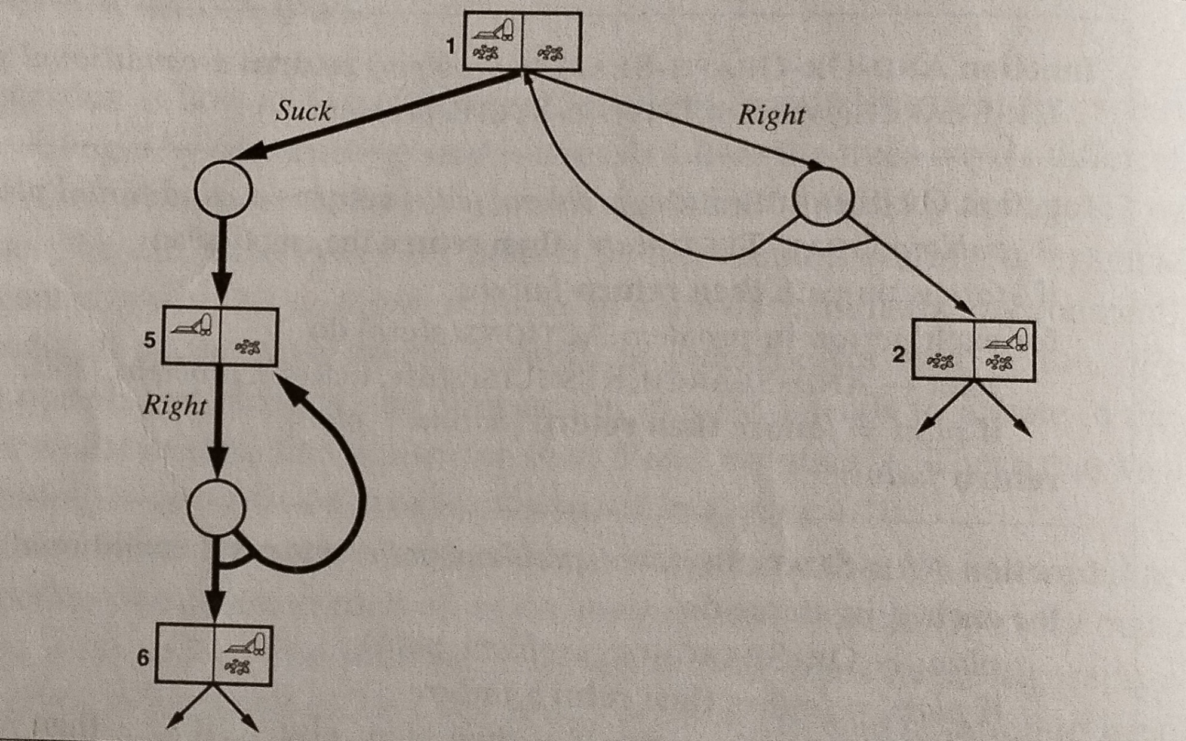
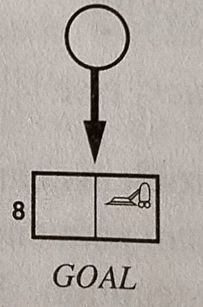
Left
Suck
Extended from Fig 4.12 pp.138 of RN

Slide 7
Plan Search, dealing with partial observability

Slide 8
What if you could plan observing nothing?
???
Sensor-less planning
Sensor cost
Sensor faults
This means we don’t know the environment beforehand.
For now we assume deterministic actions.
?
?
L
?
?
S
?
R
What were the assumptions about the environment and actions?
What made this plan possible to derive?
Will it work for the 15-puzzle?
S
?

Slide 9
Planning with belief states
A belief state is the agent’s notion of what set of real world states its state is possibly in. So it is a set of physical world states, e.g.,:
In the vacuum world, the agent may be in any one of the 8 physical states.
Therefore initial (belief) state b = {1,2,3,4,5,6,7,8}.
At some point, it may be that belief state b={1,3,5,7}
If b is a belief state then the set of possible actions:
ActionSet(b)= U_{s ε b} ActionSet(s) where s is a physical state OR
ActionSet(b)= Ռ_{s ε b} ActionSet(s) is sometimes a better model
Transition: T(b,a)→b’ where b’= U_{s ε b} T_{P}(s,a) This is called PREDICT ing the belief state
Here T is the transition in belief states, T_{P} is the transition in the physical states
A correct plan is one where in the final belief state b, all physical states s ε b are goal states.
This is what we did in the previous example of the erratic vacuum cleaner.
For simplicity assume all action costs are equal.

Slide 10
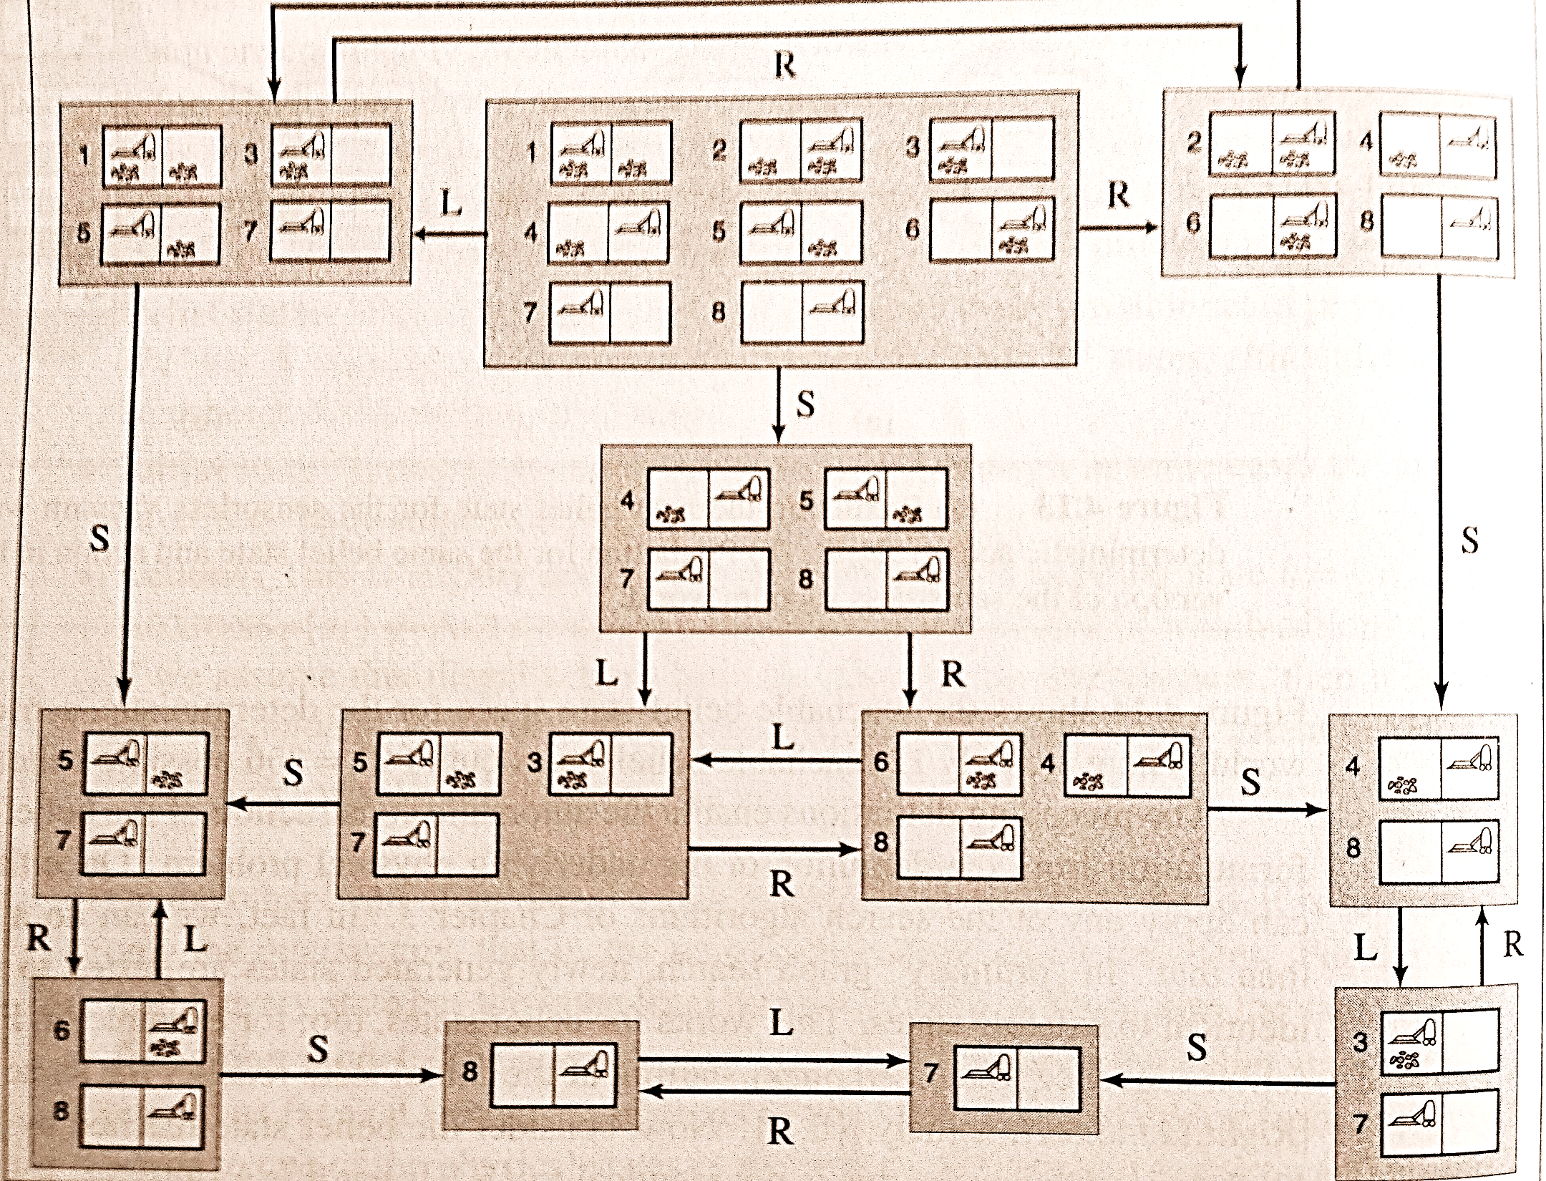
For each belief state we can predict the future belief states.
From RN

Slide 11
We can construct this graph because given the model of T_{P} and possible s at any time, assuming s is manageably sized, we can construct the graph and search for a goal finding path using BFS or DFS, or if we can model costs appropriately(?) even A*.
We could also do the corresponding memory saving versions.
We end up with a path as a plan.
Clearly for a 2 X 1 grid, #states = 2*22.
For a k X k grid, # states = ??
What is the cost for computing the next belief state?
One way to deal with this is to model what is know differently – eg a knowledge based approach with predicates etc… we do that later.

Slide 12
We can deal with this by doing a DFS(or IDS) using one initial state, then verifying it works with the others
Thus we end up with a solution that works for all initial states.
This iterative search in the belief space is space saving, however it blows up time
Advantage is it is potentially good at throwing out some paths.
However just a little observation may help to prune the state space significantly…

Slide 13
Adding a little (partial) observation
A percept only gives partial information. That may help.
If we look at the graph of the belief states of the vacuum cleaner
b = { 1,3,5,7}
B = { 1,3}
o : [A,dirty]
Observation itself causes belief state revision/ pruning
?
?
?
This is called UPDATE of the belief state
Thus for each action a in a belief state b:
UPDATE ( PREDICT(b,a), o)
gives us a more accurate state information
Note we are still doing all this offline and with a graph of belief states

Slide 14
With partial observability what does the solution look like
Because the we can take different actions based on the observations, we can build contingent plans now. The AND nodes correspond to the fact that observations can yield different states and we need to plan for both!
Also, as a bonus this helps us deal with partially observable but non-deterministic action cases too!
Another example is to deal with unknown position, but the map is known.
There are many problems unsolvable without observation, but we can create contingent plans if we have some observation.

Slide 15
An assignment
Create these environments for the path finding problem:
10x10 with 10% blocked squares (either constructed or randomly placed)
100x100 with 10% blocked squares.
1000x1000 with 10% blocked square.
Known:
Source, destination, above map including dimensions and which squares are blocked.
Action: one of 4 moves possible.
A possible heuristic is Manhattan distance.
Problem:
Create an offline plan from source to destination. Use any method from class I-DFS, A*?
What if we only have local percept info for blocked squares?
What if we created a deterministic fixed policy?
What if it were a stochastic fixed policy?

